Slide 1
Non Conformities Predix- Next releases

Slide 2
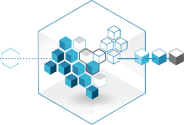


Predix Non-Conformities App
S&QM
SFDC
Internal
& Supplier
SSO
Issue Tracking App
Project
UI
Database
Internal
iOS UI
Mobile & Offline
Data Lake
MVP I POC – Q1 ‘17
MVP II – Deployment – Q3’17
MVP III – S&QM & Datalake Q4 ‘17
MVP IV – Q1 ‘18
MVP V – Q2 ‘18
iOS App only w/ offline cap. to record qual. issues
5 steps workflow to log, assign, accept, solve & close
SSO enabled, GE Store available
One way offline NC creation from Predix to SFDC
Look & feel & forms enhancements
Q3 ‘17 : One way creation from Predix to S&QM & Datalake
2 ways interface SFDC-Predix & S&QM -Predix
Android App
Web UI
Integration Slack
Forms & workflows param. via Metamodel

Slide 3
Enhancements- Summary
Content and planning of each MVP described in the next slides.
To summarize a first step for the next 6 month :
Look & Field enhancement
Interface with SFDC to complete
Interface with S&QM to develop
Link to the datalake
Other steps for next year:
SFDC/S&QM interface enhancement (update offline possible)
Web and Android UI available
In parallel, improvements of the current architecture to provide more flexibility and ensure alignment with GE standards has to be done:
At each MVP, it will be the opportunity to review and improve the application architecture if needed

Slide 4
MVP II – Q3 ‘17

Slide 5
1-Fields changes
Change Fields order :
Place at the top (just above Title) : NC Type
If NC Type = project, then display “Project Name” field just above NC Type
All the details of the project remains in the “Project Details” tab
If NC Type is different from project, then project tab is not display as well as “Project Name” field
Remove “Equipment Name” field

Slide 6
2-NCP Interface
Put in production the existing interface with NCP (SalesForce)
Currently interface is working with the dev environment of SalesForce
Ensure the record is locked in Predix once the NC has been sent and a confirmation received from NCP
Update the current interface with new/updated fields:
See detailed on the next slide

Slide 7
2-1 NCP Alignment
mandatory fields
fields with validation rules
New Field to create in Predix
Field to modify in Predix
Additional fields to map with NCP new version
Section | Predix Fields | Predix Fields
NC Details | Salesforce ID
NC Details | Detection Date | Status
NC Details
NC Details
NC Details | Product Line
NC Details | Unit | Requestor
NC Details | Severity
NC Details
NC Details
NC Details
Project Details | Project Number
Project Details | Coordinator
Project Details
Project Details | Project Name
Project Details
Project Details
Project Details
Project Details
Project Details
Equipment Details | Serial Number | Bay Number
Equipment Details |  | Compartment
Equipment Details | Equipment Type | Phase
Equipment Details | Substation Type | Gas Loss
Equipment Details |  | Quantity Lost (in Kg)
Equipment Details |  | Installation drawing
Equipment Details |  | Electrical drawing
Equipment Details
Equipment Details
NC Description | Title
NC Description | Description
Cost Of Quality | Estimated Working Hours - Supervisor
Cost Of Quality | Estimated Working Hours - Manpower
Cost Of Quality | Working Hours Cost
Cost Of Quality
Cost Of Quality
Cost Of Quality
Cost Of Quality
Cost Of Quality
Cost Of Quality
Cost Of Quality
Solution | Assigned to
Solution | Function failure
Solution | Part Involved
Solution | EHS | EHS impact
Solution | Corrective Action
Solution | Root Cause Category | Root Cause
Solution | Root Cause Details | Findings
Solution | Synthesis | Solution Proposed
Solution | Solved description/reason | Solution Description
Solution | Solved estimated date | Resolution Date
CA/PA | 8D Required ?
CA/PA | 8D number
CA/PA | 8D Corrective Action
CA/PA | Preventive Action
Actions |  | Corrective action plan
Files |  | Attachments
NC History
Chatter

Slide 8
MVP III- Q4 ‘17

Slide 9
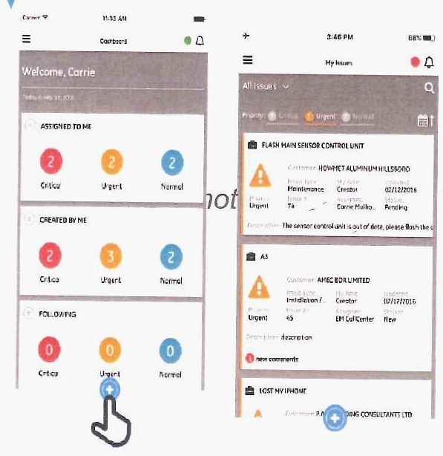
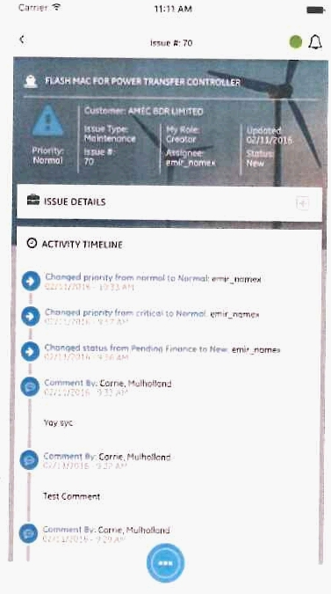
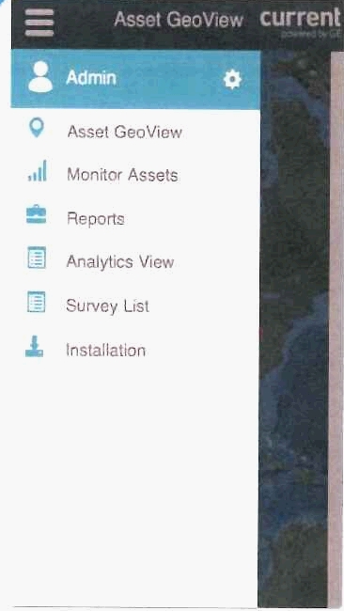
3-Look & Feel improvement
Ensure Design consistency across GE Predix applications
Add other views (assigned to me, created by me, follow…) & color code depending on the severity
Add an audit trail to get history of changes on the ticket (as designed for other Predix apps)
For example the menu accessible when you scroll on the left

Slide 10
4-S&QM Interface
Interface with S&QM:
Be able to raise a NC in the Predix mobile app, online or offline, and send it to S&QM when the NC type is supplier or internal
As a first step, same interface as NCP : when the record has been sent to S&QM and the confirmation of the reception received, the record is locked in Predix

Slide 11
MVP IV – Q1 ‘18

Slide 12
5-Sales Force & S&QM Interfaces
Enable update of records managed in SFDC/S&QM when offline with Predix apps:
Put in place the mechanism to update the NC offline as described below:
Before going on site : User loads in his mobile all NC raised and still opened for a specific project (either created first in Sales Force or in Predix)
Once on site : User updates some specific fields (in green in the next slide) offline
Once he has a connection : Fields are synchronized with SFDC/S&QM => in NCP/S&QM the new value of those updated fields is displayed

Slide 13
5-1 NCP Alignment
Mandatory fields
Update Offline after creation
Additional fields to map with NCP new version
Section | Predix Fields | Predix Fields
NC Details | Salesforce ID
NC Details | Detection Date | Status
NC Details
NC Details
NC Details | Product Line
NC Details | Unit | Requestor
NC Details | Severity
NC Details
NC Details
NC Details
Project Details | Project Number
Project Details | Coordinator
Project Details
Project Details | Project Name
Project Details
Project Details
Project Details
Project Details
Project Details
Equipment Details | Serial Number | Bay Number
Equipment Details |  | Compartment
Equipment Details | Equipment Type | Phase
Equipment Details | Substation Type | Gas Loss
Equipment Details |  | Quantity Lost (in Kg)
Equipment Details |  | Installation drawing
Equipment Details |  | Electrical drawing
Equipment Details
Equipment Details
NC Description | Title
NC Description | Description
Cost Of Quality | Estimated Working Hours - Supervisor
Cost Of Quality | Estimated Working Hours - Manpower
Cost Of Quality | Working Hours Cost
Cost Of Quality
Cost Of Quality
Cost Of Quality
Cost Of Quality
Cost Of Quality
Cost Of Quality
Cost Of Quality
Containment | Containment
Containment | Target Date
Containment | Closing Date
Solution
Solution
Solution
Solution | EHS impact
Solution
Solution | Root Cause
Solution | Findings
Solution | Solution Proposed
Solution | Solution Description
Solution | Resolution Date
CA/PA
CA/PA
CA/PA
CA/PA
Actions | Corrective action plan
Files | Attachments
NC History
Chatter
+ workflow synchronization with NCP :
Example : NC created in Predix, submitted in NCP must be seen submitted in Predix

Slide 14
5-2 Master Data and NC recover
NCP is the Master for all modifications done after NC creation. These modifications must be seen in NC Predix app
Conflict between paralleled modification on a NC (in NCP/S&QM & Predix at the same time) must be addressed
End users must be able to get back NCs per criteria (at list per project, per unit or on a period, bonus per quantity or size…)

Slide 15
MVP V – Q2‘18

Slide 16
6-Web UI
Web & Android UI
Chatter (integration with Slack)

